Slide 1
Digital System Design
Lecture 10
Design Examples II

Slide 2
Learning Examples:
LCD螢幕顯示
PS/2 Keyboard
VGA螢幕顯示
2

Slide 3
LCD 螢幕顯示

Slide 4
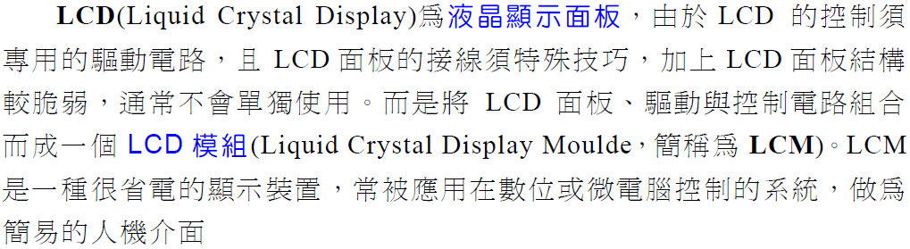
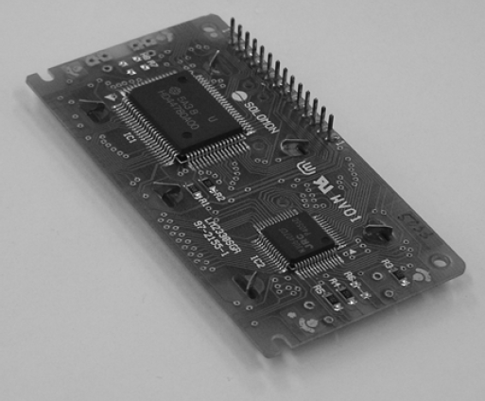
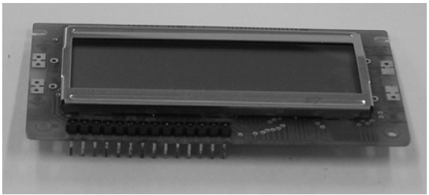
認識LCD模組 (LCM)
Notes:
credential:
bring a computer
die photo
wafer
:
This can be an hidden slide. I just want to use this to do my own planning.
I have rearranged Culler’s lecture slides slightly and add more slides. This covers everything he covers in his first lecture (and more) but may
We will save the fun part, “ Levels of Organization,” at the end (so student can stay awake): I will show the internal stricture of the SS10/20.
Notes to Patterson: You may want to edit the slides in your section or add extra slides to taylor your needs.

Slide 5
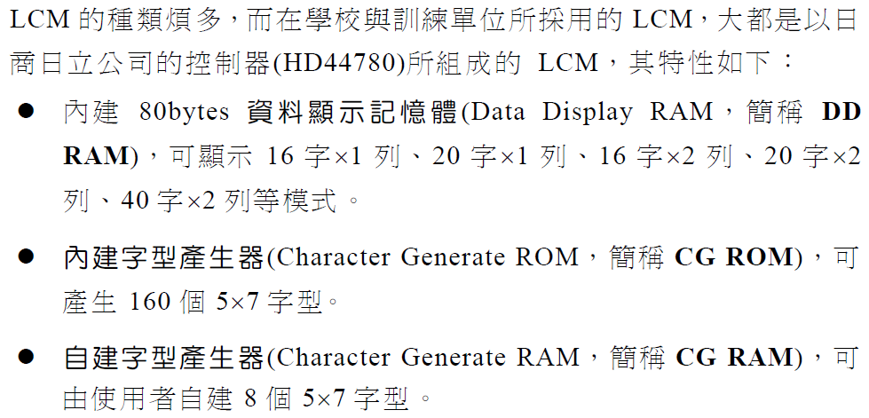
LCM基本資料
Notes:
credential:
bring a computer
die photo
wafer
:
This can be an hidden slide. I just want to use this to do my own planning.
I have rearranged Culler’s lecture slides slightly and add more slides. This covers everything he covers in his first lecture (and more) but may
We will save the fun part, “ Levels of Organization,” at the end (so student can stay awake): I will show the internal stricture of the SS10/20.
Notes to Patterson: You may want to edit the slides in your section or add extra slides to taylor your needs.

Slide 6
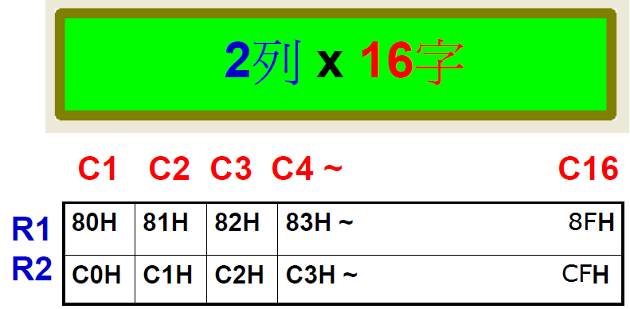
Notes:
credential:
bring a computer
die photo
wafer
:
This can be an hidden slide. I just want to use this to do my own planning.
I have rearranged Culler’s lecture slides slightly and add more slides. This covers everything he covers in his first lecture (and more) but may
We will save the fun part, “ Levels of Organization,” at the end (so student can stay awake): I will show the internal stricture of the SS10/20.
Notes to Patterson: You may want to edit the slides in your section or add extra slides to taylor your needs.

Slide 7
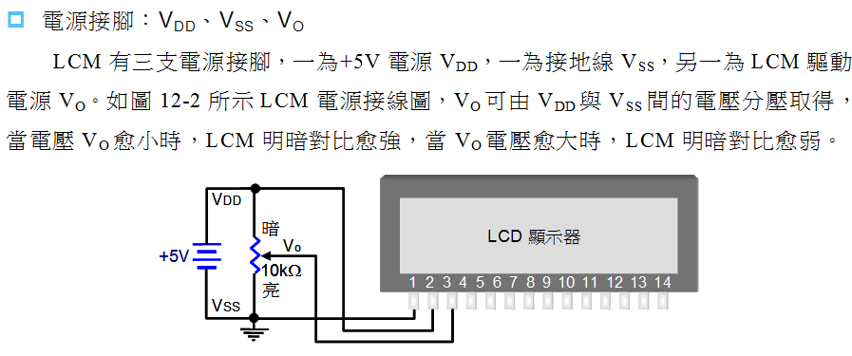
電源接腳
A K
back light
control
如果接3.3V,
畫面較暗
Notes:
credential:
bring a computer
die photo
wafer
:
This can be an hidden slide. I just want to use this to do my own planning.
I have rearranged Culler’s lecture slides slightly and add more slides. This covers everything he covers in his first lecture (and more) but may
We will save the fun part, “ Levels of Organization,” at the end (so student can stay awake): I will show the internal stricture of the SS10/20.
Notes to Patterson: You may want to edit the slides in your section or add extra slides to taylor your needs.

Slide 8
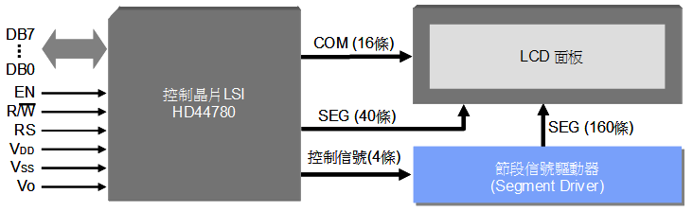
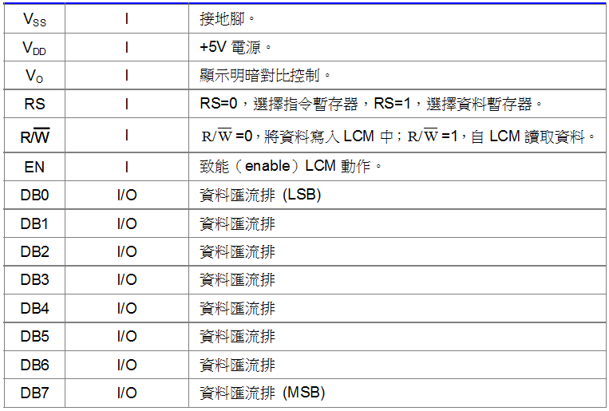
LCM腳位
Notes:
credential:
bring a computer
die photo
wafer
:
This can be an hidden slide. I just want to use this to do my own planning.
I have rearranged Culler’s lecture slides slightly and add more slides. This covers everything he covers in his first lecture (and more) but may
We will save the fun part, “ Levels of Organization,” at the end (so student can stay awake): I will show the internal stricture of the SS10/20.
Notes to Patterson: You may want to edit the slides in your section or add extra slides to taylor your needs.

Slide 9
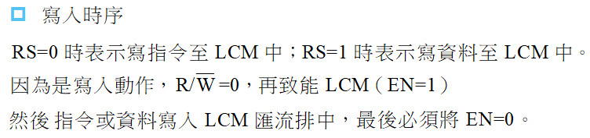
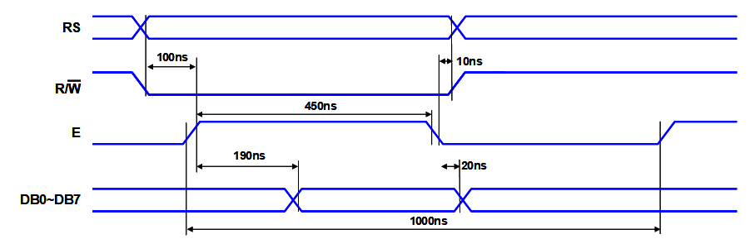
LCM Timing
1.
2.
3.
-> to latch in data
1
2
3
valid data

Slide 10
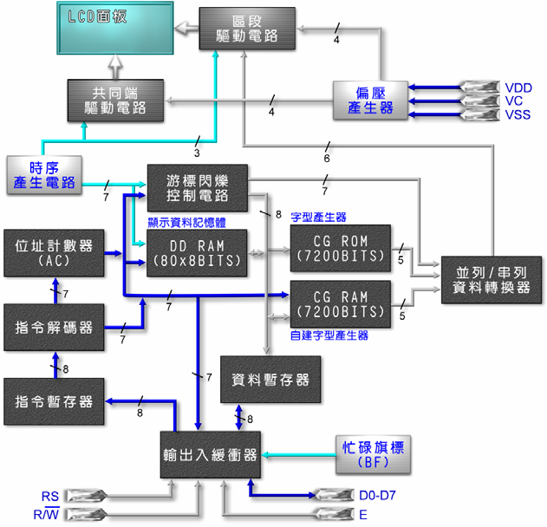
HD44780 LCM 內部結構
Notes:
credential:
bring a computer
die photo
wafer
:
This can be an hidden slide. I just want to use this to do my own planning.
I have rearranged Culler’s lecture slides slightly and add more slides. This covers everything he covers in his first lecture (and more) but may
We will save the fun part, “ Levels of Organization,” at the end (so student can stay awake): I will show the internal stricture of the SS10/20.
Notes to Patterson: You may want to edit the slides in your section or add extra slides to taylor your needs.

Slide 11
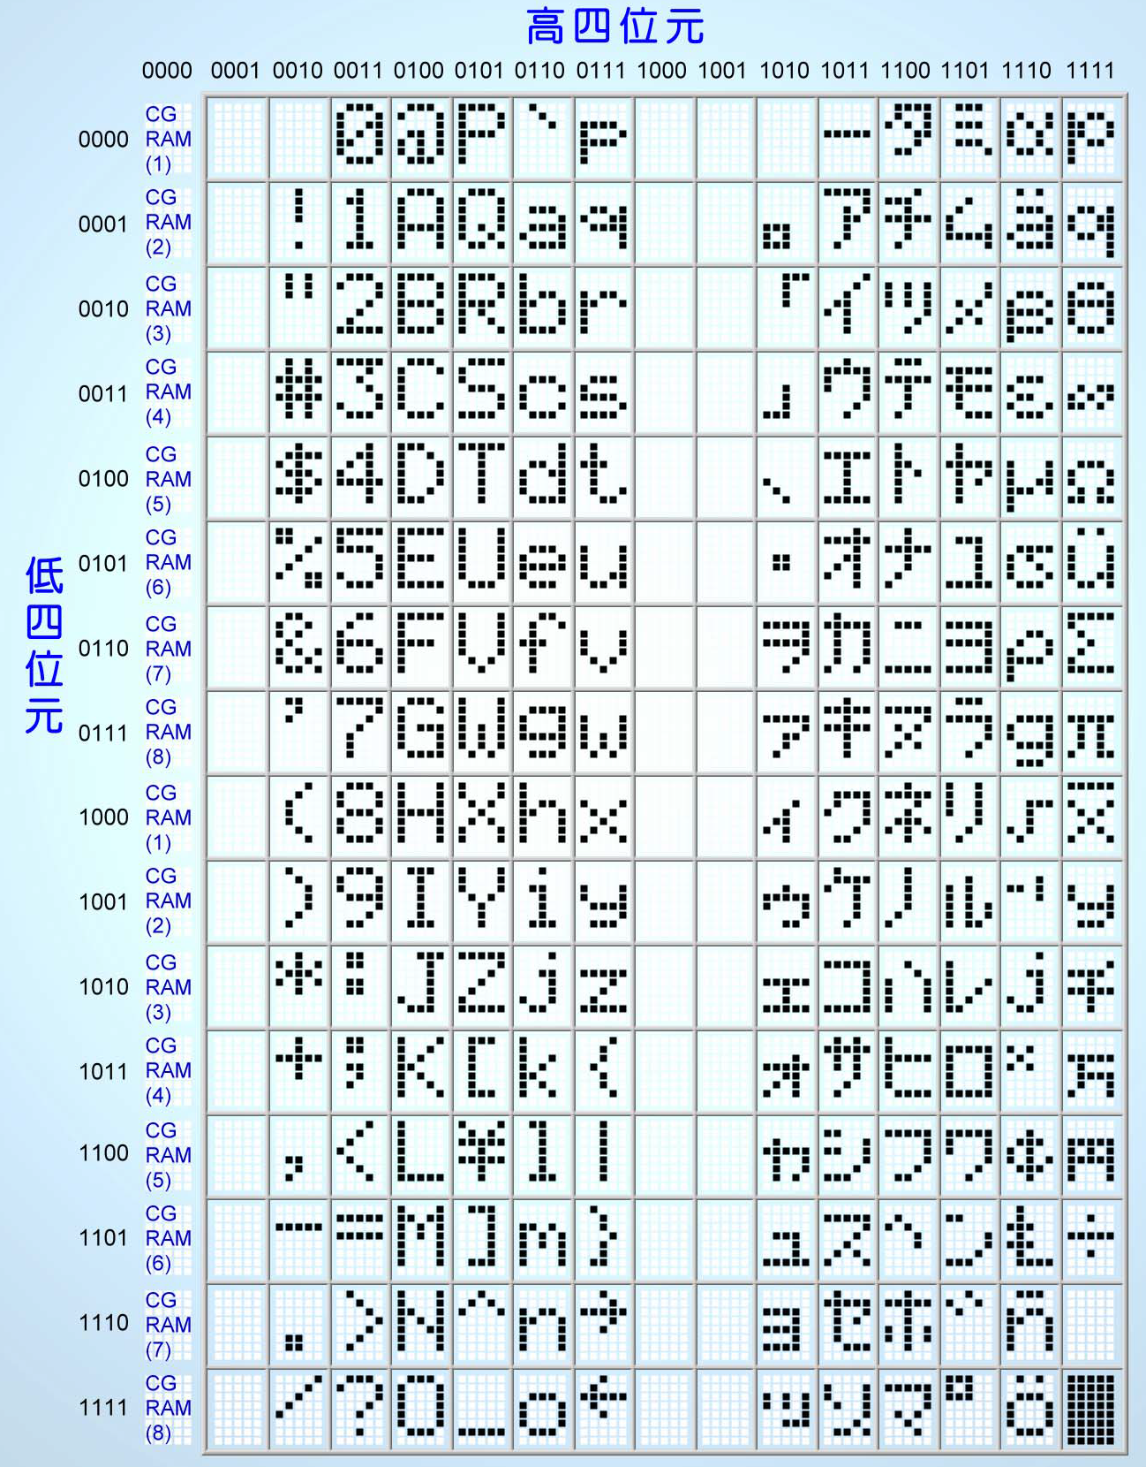
CG ROM字型
這個字型編碼表其實就是ASCII 編碼。
Notes:
credential:
bring a computer
die photo
wafer
:
This can be an hidden slide. I just want to use this to do my own planning.
I have rearranged Culler’s lecture slides slightly and add more slides. This covers everything he covers in his first lecture (and more) but may
We will save the fun part, “ Levels of Organization,” at the end (so student can stay awake): I will show the internal stricture of the SS10/20.
Notes to Patterson: You may want to edit the slides in your section or add extra slides to taylor your needs.

Slide 12
LCM的指令集
指令 | 控制訊號 |  | 指令碼(Data Bus上的資料) |  |  |  |  |  |  |  | 執行
功能 | RS | R/W | D7 | D6 | D5 | D4 | D3 | D2 | D1 | D0 | 時間
清除顯示器 | ０ | ０ | ０ | ０ | ０ | ０ | ０ | ０ | ０ | １ | 1.64ms
游標歸位 | ０ | ０ | ０ | ０ | ０ | ０ | ０ | ０ | １ | ＊ | 1.64ms
進入模式 | ０ | ０ | ０ | ０ | ０ | ０ | ０ | １ | I/D | S | 40us
顯示器開／關 | ０ | ０ | ０ | ０ | ０ | ０ | １ | D | C | B | 40us
顯示器移位 | ０ | ０ | ０ | ０ | ０ | １ | S/C | R/L | ＊ | ＊ | 40us
功能設定 | ０ | ０ | ０ | ０ | １ | DL | N | F | ＊ | ＊ | 40us
設定CG ram位址 | ０ | ０ | ０ | １ | CG RAM 的位址 |  |  |  |  |  | 40us
設定DD ram位址 | ０ | ０ | １ | DD RAM 的位址 |  |  |  |  |  |  | 40us
讀取忙碌旗標 | ０ | １ | BF | 位址計數器 |  |  |  |  |  |  | 40us
寫入資料 | １ | ０ | 寫入的資料 |  |  |  |  |  |  |  | 40us
讀取資料 | １ | １ | 讀取的資料 |  |  |  |  |  |  |  | 40us
CG RAM：是一個可以由使用者自行設定字型的地方，LCM共有64個位元組的CG RAM使用者可以在這些方自行造字，一般而言一個顯示位置，對應到CG RAM的八個位元組，所以使用者可自行造八個字型。
DD RAM：LCM上不管那種文字型的LCM，其內部提供80個位元組的顯示記憶體，使用者可以將欲顯示的料放入這些位置上，就會顯示在相對應的顯示幕上。

Slide 13
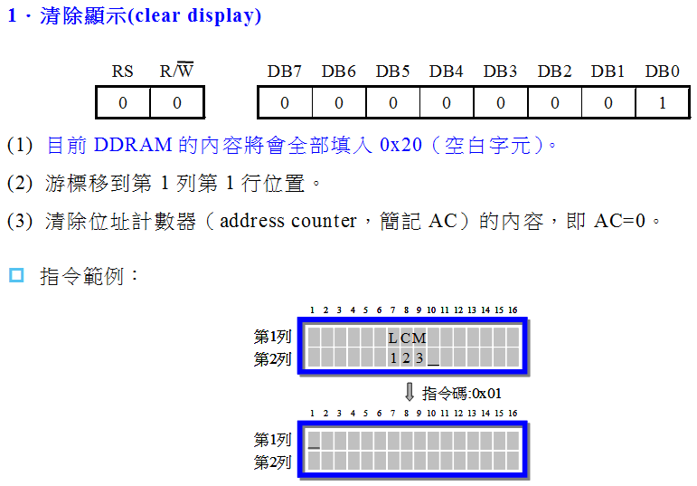
LCM控制指令 - 1
LCM 控制指令只有11 個，依序介紹這下：
Notes:
credential:
bring a computer
die photo
wafer
:
This can be an hidden slide. I just want to use this to do my own planning.
I have rearranged Culler’s lecture slides slightly and add more slides. This covers everything he covers in his first lecture (and more) but may
We will save the fun part, “ Levels of Organization,” at the end (so student can stay awake): I will show the internal stricture of the SS10/20.
Notes to Patterson: You may want to edit the slides in your section or add extra slides to taylor your needs.

Slide 14
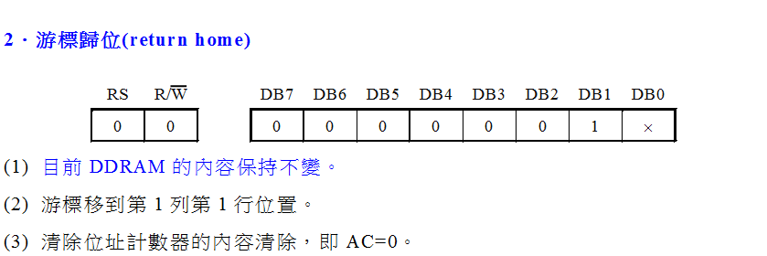
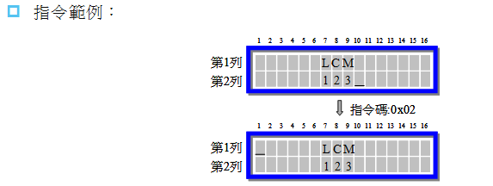
LCM控制指令 - 2
Notes:
credential:
bring a computer
die photo
wafer
:
This can be an hidden slide. I just want to use this to do my own planning.
I have rearranged Culler’s lecture slides slightly and add more slides. This covers everything he covers in his first lecture (and more) but may
We will save the fun part, “ Levels of Organization,” at the end (so student can stay awake): I will show the internal stricture of the SS10/20.
Notes to Patterson: You may want to edit the slides in your section or add extra slides to taylor your needs.

Slide 15
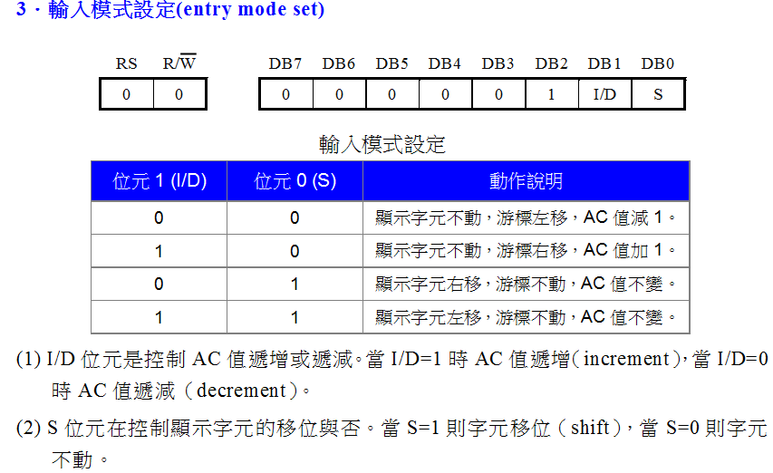
LCM控制指令 - 3
Notes:
credential:
bring a computer
die photo
wafer
:
This can be an hidden slide. I just want to use this to do my own planning.
I have rearranged Culler’s lecture slides slightly and add more slides. This covers everything he covers in his first lecture (and more) but may
We will save the fun part, “ Levels of Organization,” at the end (so student can stay awake): I will show the internal stricture of the SS10/20.
Notes to Patterson: You may want to edit the slides in your section or add extra slides to taylor your needs.

Slide 16
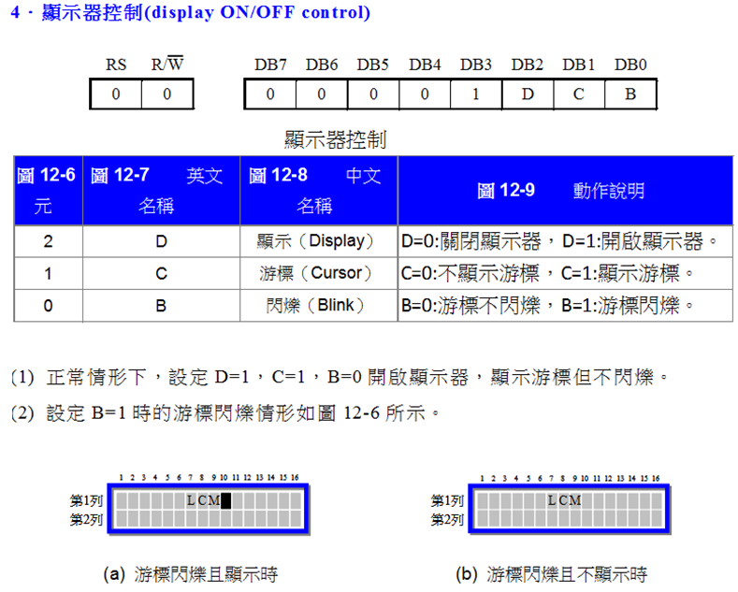
LCM控制指令 - 4
Notes:
credential:
bring a computer
die photo
wafer
:
This can be an hidden slide. I just want to use this to do my own planning.
I have rearranged Culler’s lecture slides slightly and add more slides. This covers everything he covers in his first lecture (and more) but may
We will save the fun part, “ Levels of Organization,” at the end (so student can stay awake): I will show the internal stricture of the SS10/20.
Notes to Patterson: You may want to edit the slides in your section or add extra slides to taylor your needs.

Slide 17
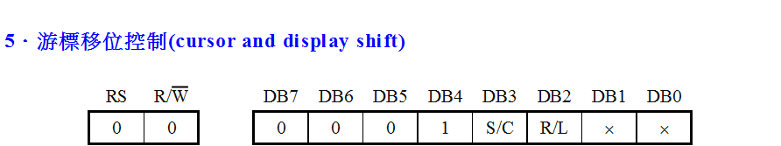
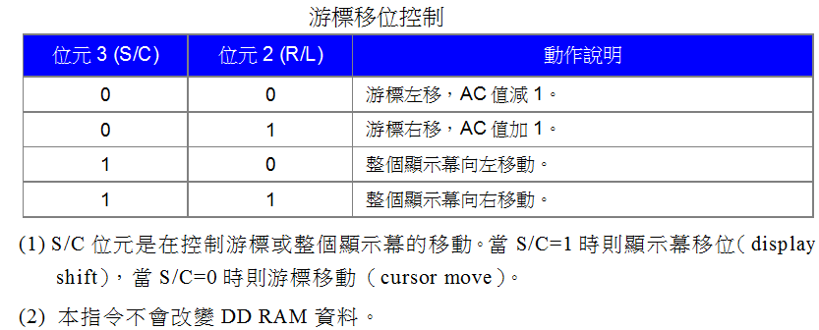
LCM控制指令 - 5
Notes:
credential:
bring a computer
die photo
wafer
:
This can be an hidden slide. I just want to use this to do my own planning.
I have rearranged Culler’s lecture slides slightly and add more slides. This covers everything he covers in his first lecture (and more) but may
We will save the fun part, “ Levels of Organization,” at the end (so student can stay awake): I will show the internal stricture of the SS10/20.
Notes to Patterson: You may want to edit the slides in your section or add extra slides to taylor your needs.

Slide 18
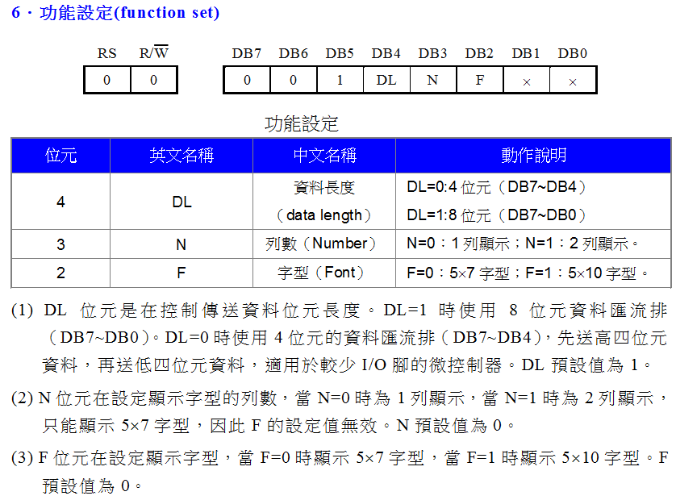
LCM控制指令 - 6
Notes:
credential:
bring a computer
die photo
wafer
:
This can be an hidden slide. I just want to use this to do my own planning.
I have rearranged Culler’s lecture slides slightly and add more slides. This covers everything he covers in his first lecture (and more) but may
We will save the fun part, “ Levels of Organization,” at the end (so student can stay awake): I will show the internal stricture of the SS10/20.
Notes to Patterson: You may want to edit the slides in your section or add extra slides to taylor your needs.

Slide 19
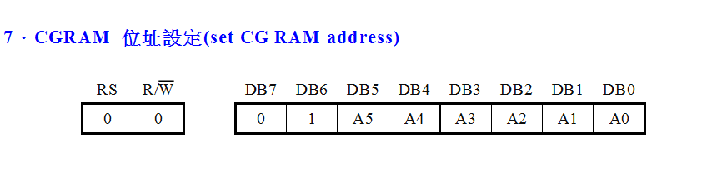
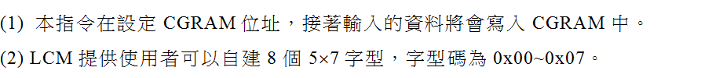
LCM控制指令 - 7
Notes:
credential:
bring a computer
die photo
wafer
:
This can be an hidden slide. I just want to use this to do my own planning.
I have rearranged Culler’s lecture slides slightly and add more slides. This covers everything he covers in his first lecture (and more) but may
We will save the fun part, “ Levels of Organization,” at the end (so student can stay awake): I will show the internal stricture of the SS10/20.
Notes to Patterson: You may want to edit the slides in your section or add extra slides to taylor your needs.

Slide 20
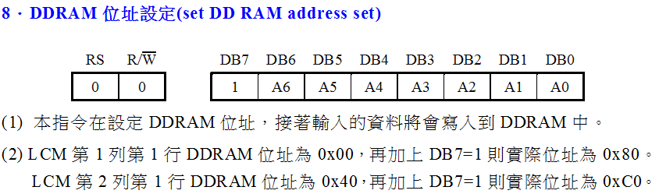
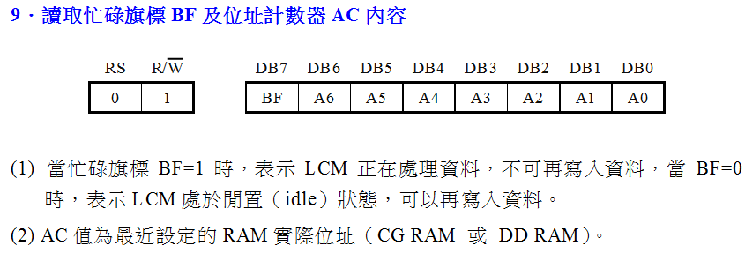
LCM控制指令 – 8, 9
Notes:
credential:
bring a computer
die photo
wafer
:
This can be an hidden slide. I just want to use this to do my own planning.
I have rearranged Culler’s lecture slides slightly and add more slides. This covers everything he covers in his first lecture (and more) but may
We will save the fun part, “ Levels of Organization,” at the end (so student can stay awake): I will show the internal stricture of the SS10/20.
Notes to Patterson: You may want to edit the slides in your section or add extra slides to taylor your needs.

Slide 21
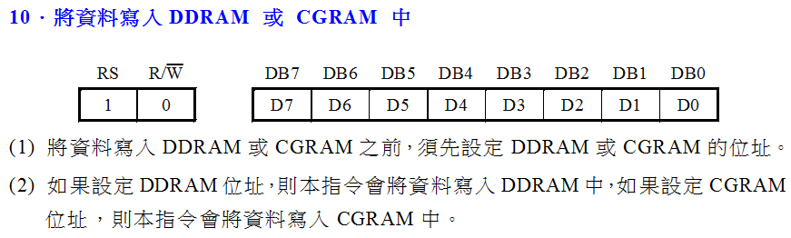
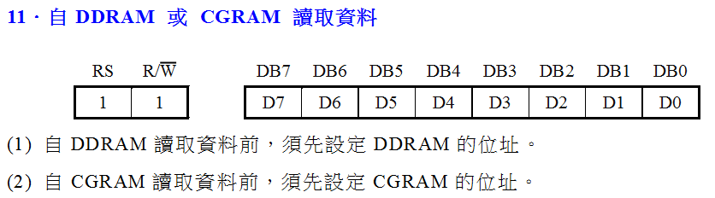
LCM控制指令 – 10, 11
Notes:
credential:
bring a computer
die photo
wafer
:
This can be an hidden slide. I just want to use this to do my own planning.
I have rearranged Culler’s lecture slides slightly and add more slides. This covers everything he covers in his first lecture (and more) but may
We will save the fun part, “ Levels of Organization,” at the end (so student can stay awake): I will show the internal stricture of the SS10/20.
Notes to Patterson: You may want to edit the slides in your section or add extra slides to taylor your needs.

Slide 22
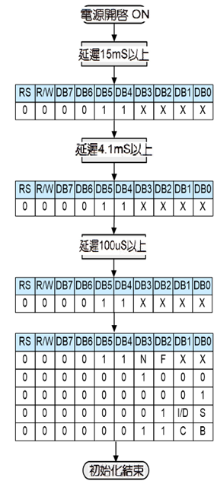

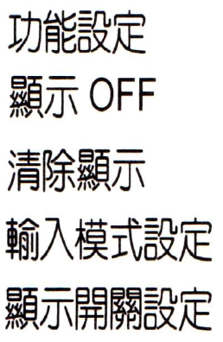
8位元模式的初始設定範例
Notes:
credential:
bring a computer
die photo
wafer
:
This can be an hidden slide. I just want to use this to do my own planning.
I have rearranged Culler’s lecture slides slightly and add more slides. This covers everything he covers in his first lecture (and more) but may
We will save the fun part, “ Levels of Organization,” at the end (so student can stay awake): I will show the internal stricture of the SS10/20.
Notes to Patterson: You may want to edit the slides in your section or add extra slides to taylor your needs.

Slide 23
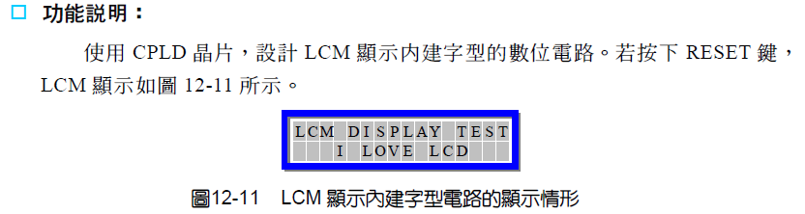
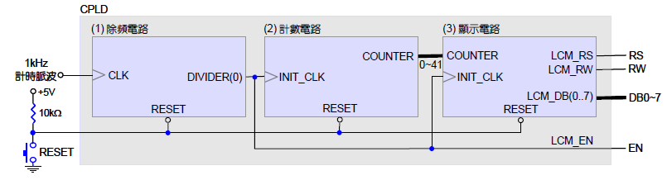
Example 1: Print Strings on LCD ( lcd_cgrom.vhd )
Using a counter
Source: CPLD 數位邏輯設計實務

Slide 24
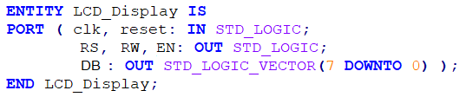
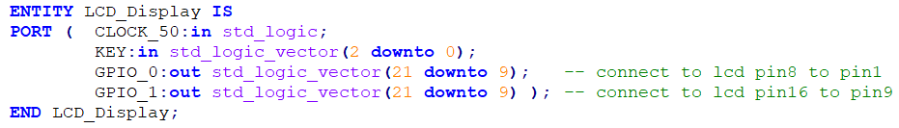
Example 1: Print Strings on LCD ( lcd_cgrom.vhd )
Implementation on DE0

Slide 25
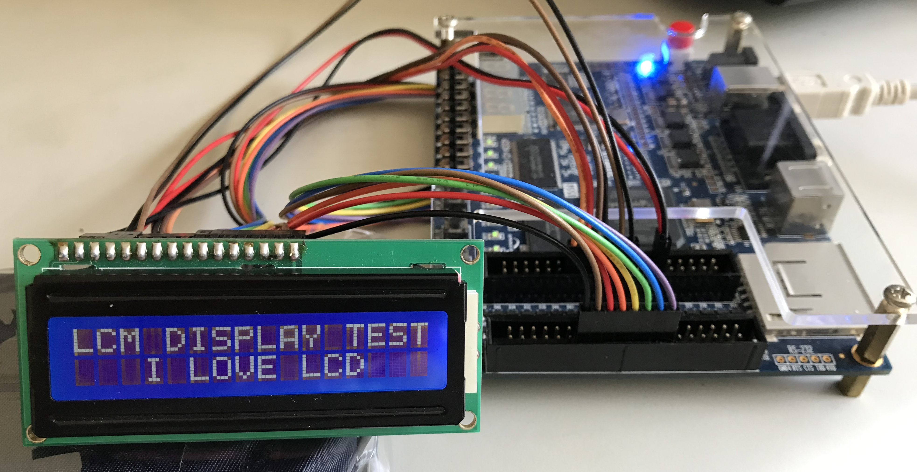
Connection between LCD module and DE0 GPIOs
gpio0
gpio1
25

Slide 26
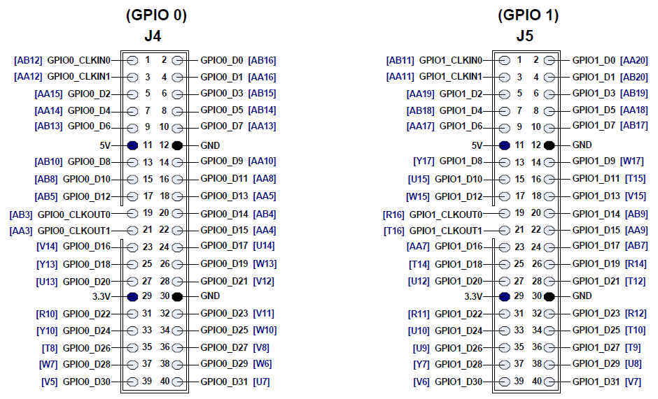
Connection between LCD module and DE0 GPIOs
pin2
pin1
LCM_DB(2)
LCM_DB(3)
GND
LCM_DB(4)
LCM_RS
LCM_DB(5)
LCM_RW
LCM_DB(6)
LCM_EN
LCM_DB(7)
LCM_DB(0)
背光電源正極
LCM_DB(1)
背光電源負極
26

Slide 27
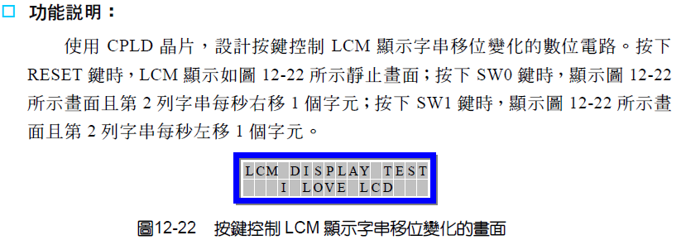
Example 2: Shift Characters on LCD ( lcd_shift.vhd )
Press Key(0) : reset
Press Key(1) : shift right
Using Key(2) : shift left
Source: CPLD 數位邏輯設計實務

Slide 28
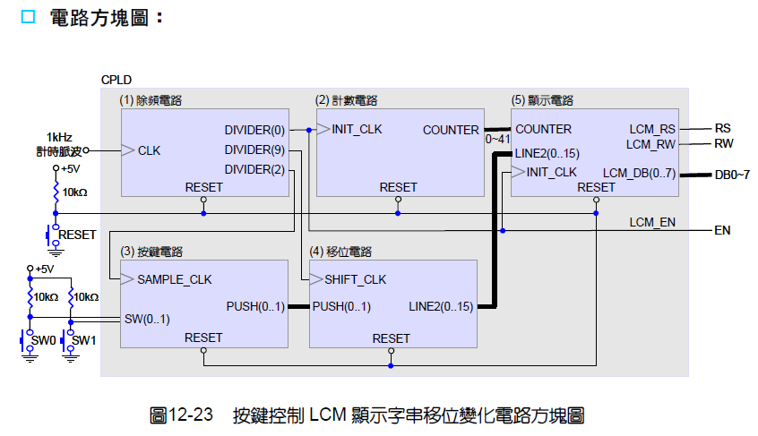
Example 2: Shift Characters on LCD ( lcd_shift.vhd )
Source: CPLD 數位邏輯設計實務

Slide 29
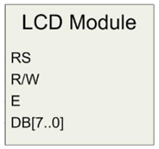
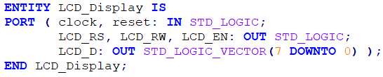
Example 3: Print Strings on LCD ( lcd_display_v1.vhd )
Using a Finite State Machine
Print “MCU Digital…..” on the 1st line, and “System Design...” on the 2nd line.
LCD_Display
clock
LCD_RS
reset
LCD_RW
LCD_EN
LCD_D
Implementation on DE0

Slide 30
Example 3: Print Strings on LCD ( lcd_display_v1.vhd )
Using a Finite State Machine
State diagram
1st line position setup
reset
init1
init2
s10
s11
s12
s13
Index+1<=7
Index+1<=15
hold
s23
s22
s21
s20
2nd line position setup
Index+1<=15

Slide 31
Example 4: Print Strings on LCD ( lcd_display_v2.vhd )
Using a Finite State Machine
State diagram
Index+1<=7
1st line position setup
Index<=15
2nd line position setup
Index<=15
reset
init
s10
s1c
s20
s2c
hold

Slide 32
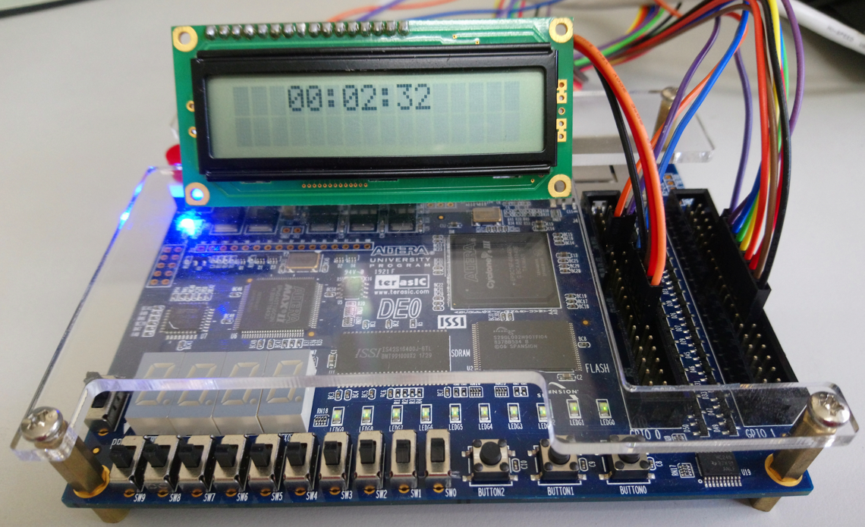
Example 5: 24時制電子鐘 on LCD ( lcd_clock.vhd )
Show “ HH:MM:SS ” on the 1st line.

Slide 33
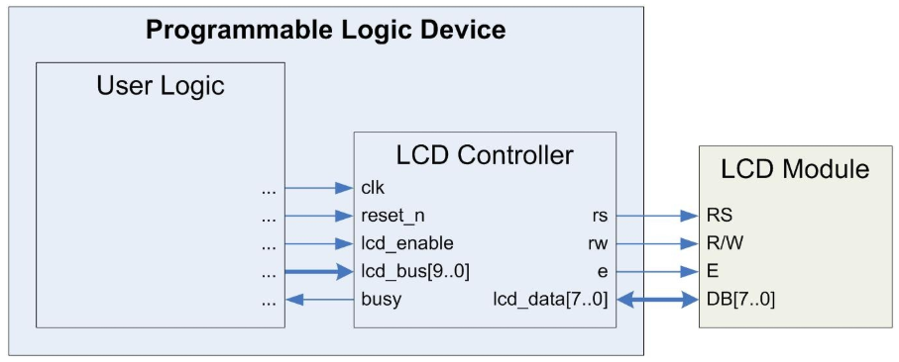
Example 6: Print Strings on LCD
Using a 3rd party IP component (lcd_controller.vhd)
The controller manages the initialization and data flow to HD44780 compatible 8-bit interface character LCD modules.
This component allows simple LCD integration into practically any programmable logic application.
lcd_example.vhd
lcd_controller.vhd

Slide 34
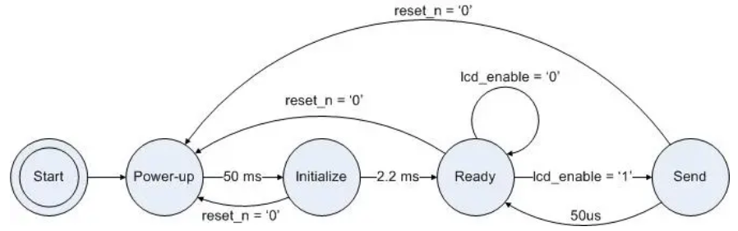
LCD Controller State Machine
The LCD controller state machine consists of five states. Upon startup, it immediately enters the Power-up state, where it waits 50ms to ensure the supply voltage has stabilized. It then proceeds to an Initialize state.
The controller cycles the LCD through its initialization sequence, setting the LCD’s parameters to default values defined in the hardware. This process completes in approximately 2.2ms, and the controller subsequently assumes a Ready state.
It waits in this state until the lcd_enable input is asserted, then advances to the Send state. Here, it communicates the appropriate information to the LCD, as defined by the lcd_bus input. After 50us, it returns to the Ready state until further notice.
If a low logic level is applied to the reset_n input at any time for a minimum of one clock cycle, the controller resets to the Power-up state and re-initializes.

Slide 35
LCD Controller State Machine
The LCD controller executes an initialization sequence each time it is powered-up or the reset_n pin is deasserted for a minimum of one clock cycle. The controller asserts the busy pin during initialization.
The initialization sequence specifies several LCD parameters: function, display control, display clear, and entry mode. The LCD controller instantiates the following default set of these options.
Function Set: 2-line mode, display on
Display Control: display on, cursor off, blink off
Entry Mode: increment mode, entire shift off
The user can send commands to the LCD to change any parameters after initialization.

Slide 36
PS/2 Keyboard

Slide 37
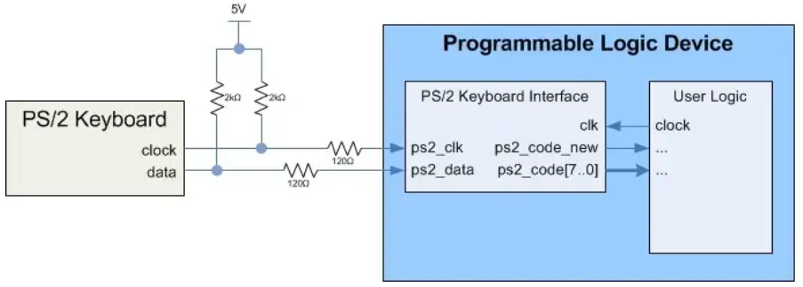
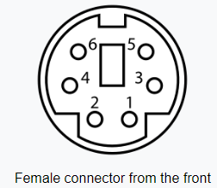
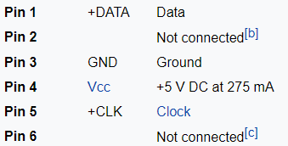
PS/2 Keyboard Interface
The PS/2 interface was originally developed for the IBM PC/AT’s mouse and keyboard in 1984. The Altera FPGA boards support the use of either a mouse or keyboard using a PS/2 connector on the board (not both at the same time).
The PS/2 port consists of 6 pins including ground, power (VDD), keyboard data, and a keyboard clock line.
37

Slide 38
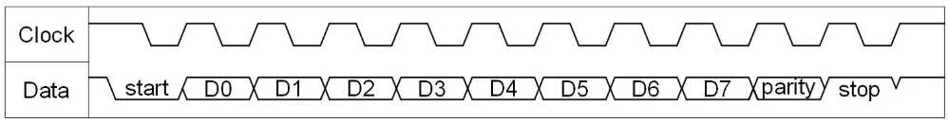
PS/2 Keyboard Transmission Timing Diagram
The keyboard provides both the clock and data. The clock has a frequency between 10 kHz and 16.7 kHz (i.e. a 60-100us period).
The data begins with a start bit (logic low), followed by one byte of data, a parity bit, and finally a stop bit (logic high).
The data is sent LSB first. Each bit should be read on the falling edge of the clock signal.
Once complete, both the clock and data signals return to logic level high.
1. A start bit ('0')
2. 8 data bits containing the key scan code in low to high bit order
3. Odd parity bit such that the eight data bits plus the parity bit are an odd
number of ones
4. A stop bit ('1')
38

Slide 39
Scan Codes
The data byte represents part of a keyboard scan code: either a make code (key press) or a break code (key release).
One make code is sent every time a key is pressed. When a key is released, a break code is sent.
A make code usually consists of either one or two bytes. If a make code uses two bytes, the first byte is x“E0”.
A given key’s break code is typically the same as its make code, except that break codes include an additional x“F0” byte as the 2nd to last byte.
39

Slide 40
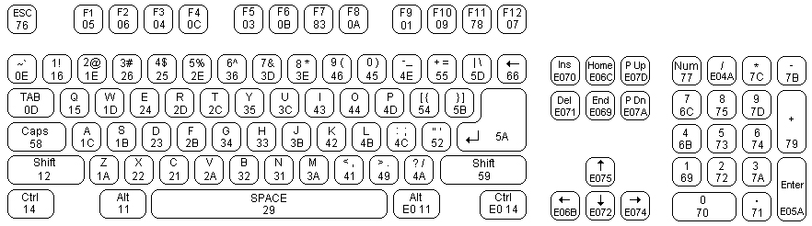
Common Scan Codes for PS/2 Keyboard
40

Slide 41
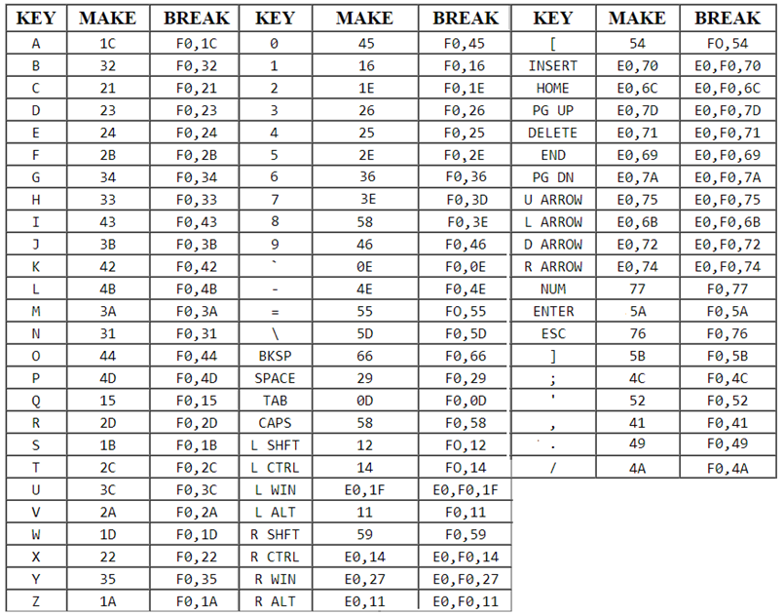
Common Scan Codes for PS/2 Keyboard
41

Slide 42
VHDL for PS/2 Keyboard Interface ( ps2_keyboard.vhd )
42

Slide 43
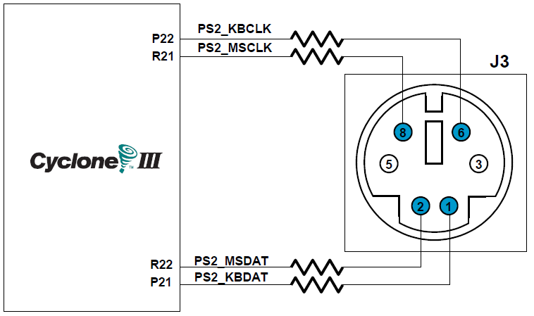
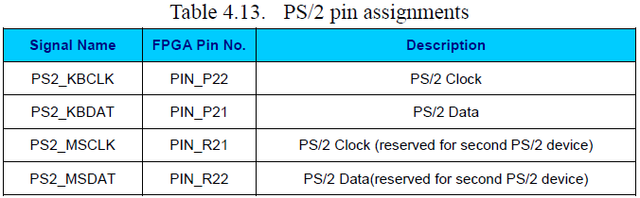
Connection between PS/2 Serial Port and DE0
KB: Keyboard
MS: Mouse
43

Slide 44
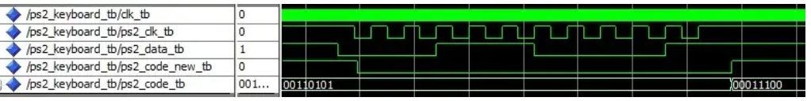
Transaction
Once the PS/2 clock signal goes low, the ps2_code_new flag deasserts to indicate that a new PS/2 keyboard transaction is in progress.
When the transaction completes, the ps2_code_new flag asserts to indicate that a new PS/2 code has been received and is available on the ps2_code bus.
In this case, the PS/2 code received is x“1C”, which is the make code for the “A” key.
8 bits
44

Slide 45

Example: PS/2 Keyboard to ASCII Converter
The component receives data transactions from a PS/2 keyboard and provides the corresponding ASCII codes to user logic over a parallel interface.
All character keys have their respective ASCII codes output by the PS/2 to ASCII converter, when those keys are pressed in a standard fashion (with respect to shift, caps lock, etc.).
The converter also outputs control codes for the additional following keys: backspace (BS), tab (HT), enter (CR), escape (ESC), and delete (DEL).
45

Slide 46
Example: PS/2 Keyboard to ASCII Converter
The PS/2 codes provided by the PS/2 keyboard interface component control the converter’s state machine.
Upon start-up, the component immediately enters the ready state. It waits in this state until it receives a new PS/2 code.
The new_code state builds the PS/2 make or break codes. If the new code received is the last byte in the make/break code, the state machine proceeds to the translate state, otherwise it returns to the ready state to await the next byte.
Once in the translate state, the converter determines which key was pressed and translates it into ASCII.
If the code is a break code, then no action is needed, so the converter ignores the code and returns to the ready state.
However, if a make code was received, the converter proceeds to the output state, where it outputs the resultant ASCII code on the ascii_code bus and sets the ascii_new output flag to indicate that the new code is available.
The converter then returns to the ready state to await the next communication from the PS/2 keyboard interface component.
46

Slide 47

Example: PS/2 Keyboard to ASCII Converter
State Diagram:
47

Slide 48
Example: PS/2 Keyboard to ASCII Converter
The source code for the PS/2 keyboard to ASCII converter consists of the following three files:
ps2_keyboard_to_ascii.vhd
ps2_keyboard.vhd
debounce.vhd
The ps2_keyboard_to_ascii.vhd file is the top level VHDL. It instantiates the PS/2 keyboard interface component (ps2_keyboard.vhd). The PS/2 keyboard interface component in turn instantiates the debounce component (debounce.vhd).
48

Slide 49

VHDL for PS/2 Keyboard to ASCII Converter
Note: these assignments are completed only after the process ends. So far, they’re still the values determined in “new_code” state.
49

Slide 50

ASCII Code
Notes:
credential:
bring a computer
die photo
wafer
:
This can be an hidden slide. I just want to use this to do my own planning.
I have rearranged Culler’s lecture slides slightly and add more slides. This covers everything he covers in his first lecture (and more) but may
We will save the fun part, “ Levels of Organization,” at the end (so student can stay awake): I will show the internal stricture of the SS10/20.
Notes to Patterson: You may want to edit the slides in your section or add extra slides to taylor your needs.

Slide 51

Transaction
Once the internal PS/2 keyboard interface finishes receiving the PS/2 transaction, the ascii_new flag deasserts to indicate that a new PS/2 to ASCII conversion is in progress.
When the transaction completes, the ascii_new flag asserts to indicate that a new ASCII code has been received and is available on the ascii_code bus.
In this case, the PS/2 code received is x“1C” (the make code for the “A” key), and the resulting ASCII code is x“61” (the ASCII code for the “a” character).
7 bits
51

Slide 52
VGA螢幕顯示

Slide 53

VGA Video Display Technology
In standard VGA format, the screen contains 640x480 pixels
– 640 pixels in a row
– 480 rows
The standard refresh rate for a screen is ~ 60 Hz
– The entire screen is refreshed 60 times per second
53

Slide 54

VGA Clock Information
54

Slide 55


Horizontal Refresh Cycle
55

Slide 56

水平同步信號波形與其對應的計數值
Parameters | A | B | C | D | E
Time | 31.77us | 3.77us | 1.89us | 25.17us | 0.94us
Clocks | 800 | 96 | 44 | 640 | 20
56

Slide 57

Vertical Refresh Cycle
57

Slide 58

垂直同步信號波形與其對應的計數值
Parameters | O | P | Q | R | S
Time | 16.68ms | 64us | 1.02ms | 15.25ms | 0.35ms
Clocks | 525 | 2 | 30 | 480 | 14
58

Slide 59

VGA Video on the DE0 Board
There is a 4-bit DAC resistor network used to produce the analog data signals (red, green, and blue).
analog signals

Slide 60


範例: 控制R,G,B輸入以在VGA螢幕上顯示八種不同的顏色
VGA_sync
RGB_display
60

Slide 61

範例: 控制R,G,B輸入以在VGA螢幕上顯示八種不同的顏色
<Block Diagram>
61

Slide 62


VHDL: VGA_sync
62

Slide 63

VHDL: VGA_sync
63

Slide 64

VHDL: VGA_sync
64

Slide 65


VHDL: RGB_display
65

Slide 66

在VGA螢幕上顯示紅白藍橫條
VGA_sync
Hbar_display
66

Slide 67

在VGA螢幕上顯示紅白藍橫條
<Block Diagram>
67

Slide 68

VHDL: Hbar_display
68

Slide 69
VGA Timings
Format | Pixel Clock (MHz) | Horizontal (in Pixels) |  |  |  | Vertical (in Lines)
 |  | Active Video | Front Porch | Sync Pulse | Back Porch | Active Video | Front Porch | Sync Pulse | Back Porch
640x480, 60Hz | 25.175 | 640 | 16 | 96 | 48 | 480 | 11 | 2 | 31
640x480, 72Hz | 31.500 | 640 | 24 | 40 | 128 | 480 | 9 | 3 | 28
640x480, 75Hz | 31.500 | 640 | 16 | 96 | 48 | 480 | 11 | 2 | 32
640x480, 85Hz | 36.000 | 640 | 32 | 48 | 112 | 480 | 1 | 3 | 25
800x600, 56Hz | 38.100 | 800 | 32 | 128 | 128 | 600 | 1 | 4 | 14
800x600, 60Hz | 40.000 | 800 | 40 | 128 | 88 | 600 | 1 | 4 | 23
800x600, 72Hz | 50.000 | 800 | 56 | 120 | 64 | 600 | 37 | 6 | 23
800x600, 75Hz | 49.500 | 800 | 16 | 80 | 160 | 600 | 1 | 2 | 21
800x600, 85Hz | 56.250 | 800 | 32 | 64 | 152 | 600 | 1 | 3 | 27
1024x768, 60Hz | 65.000 | 1024 | 24 | 136 | 160 | 768 | 3 | 6 | 29
1024x768, 70Hz | 75.000 | 1024 | 24 | 136 | 144 | 768 | 3 | 6 | 29
1024x768, 75Hz | 78.750 | 1024 | 16 | 96 | 176 | 768 | 1 | 3 | 28
1024x768, 85Hz | 94.500 | 1024 | 48 | 96 | 208 | 768 | 1 | 3 | 36
1280x1024, 60Hz | 108.00 | 1280 | 48 | 112 | 248 | 768 | 1 | 3 | 38
HDMI 720P 1280x720p 60Hz | 75.25 | 1280 | 72 | 80 | 216 | 720 | 3 | 5 | 30
HDMI 1080P 1920x1040 60Hz | 148.5 | 1920 | 88 | 44 | 148 | 1080 | 4 | 5 | 36
Source: Rick Ballantyne, Xilinx Inc.
69

